Slide 1

Learn Programming For Kids (Python)

Slide 2
Lesson 8
Functions and Modules in Python

Slide 3
11. Functions and Modules in Python
Functions and Modules provide us with reusability and organization of code. Let’s understand in an easy manner:

Slide 4
11.1. Function in Python
A function is a block of code that performs a specific task.

Slide 5
Example: Let’s consider a pizza-making process. Imagine you have a pizza recipe that consists of several steps like preparing the dough, adding toppings, and baking it.
Each step can be represented as a function:
prepare_dough() – This function prepares the pizza dough.
add_toppings() – This function adds various toppings to the pizza.
bake_pizza() – This function bakes the pizza in the oven.

Slide 7
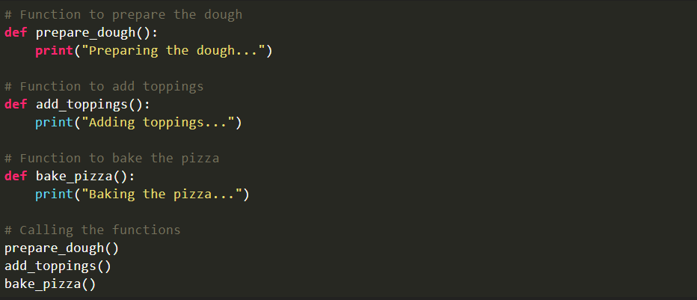
Code:

Slide 8
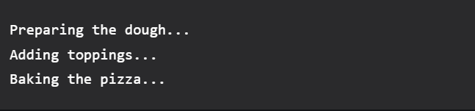
Output:

Slide 9
By creating functions for each step, you can easily follow the recipe and reuse those functions whenever you want to make another pizza.

Slide 10
Play with Python Functions:

Slide 11
Python Function to find volume, surface area and space diagonal of a cuboid

Slide 12
11.2. Modules in Python
Modules are files containing Python code that can be imported into other programs.

Slide 13
Example: Continuing with the pizza process, let’s say you have a separate recipe book (module) that contains multiple pizza recipes. Each recipe can be a separate function within the module.
Each recipe is in a different file/module:
recipe1.py – This module contains the functions for making a Margherita pizza.
recipe2.py – This module contains the functions for making a Pepperoni pizza.
recipe3.py – This module contains the functions for making a Veggie Supreme pizza.
Now, whenever you want to make a specific type of pizza, you can import the corresponding module and use the functions defined in it. For example, if you want to make a Margherita pizza, you have to import the “recipe1” module and call the functions within it to prepare the dough, add toppings, and bake the pizza.

Slide 14
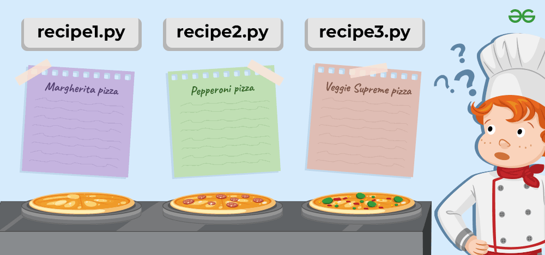

Slide 15
Play with Modules in Python:

Slide 16
Creating a simple Python Module

